Slide 1
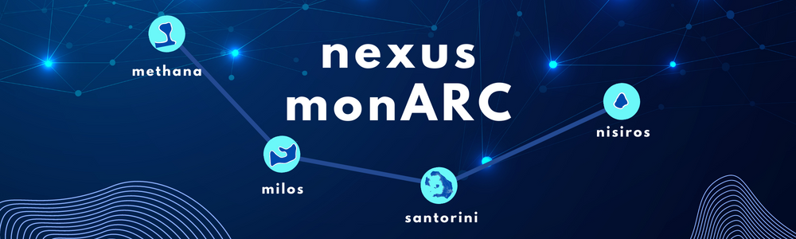

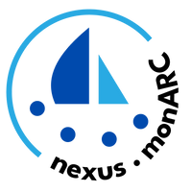

nexus monARC Newsletter
VOL. 4
Welcome to the 4th issue of the nexus monARC Newsletter!
The nexus monARC team continues to advance holistic monitoring of multi-stressor marine environments across the Hellenic Volcanic Arc. In this issue, we highlight our latest webinar on the DPSIR framework, celebrate the success of our 2nd Summer School in Methana, and share updates from recent missions, podcasts, and outreach activities. Stay tuned for insights into our research and our final event in Athens!
HERE'S WHAT'S UP!
2 – Highlights
3 – Key Takeaways and Milestones
4 – Looking Ahead to 2026

Slide 2
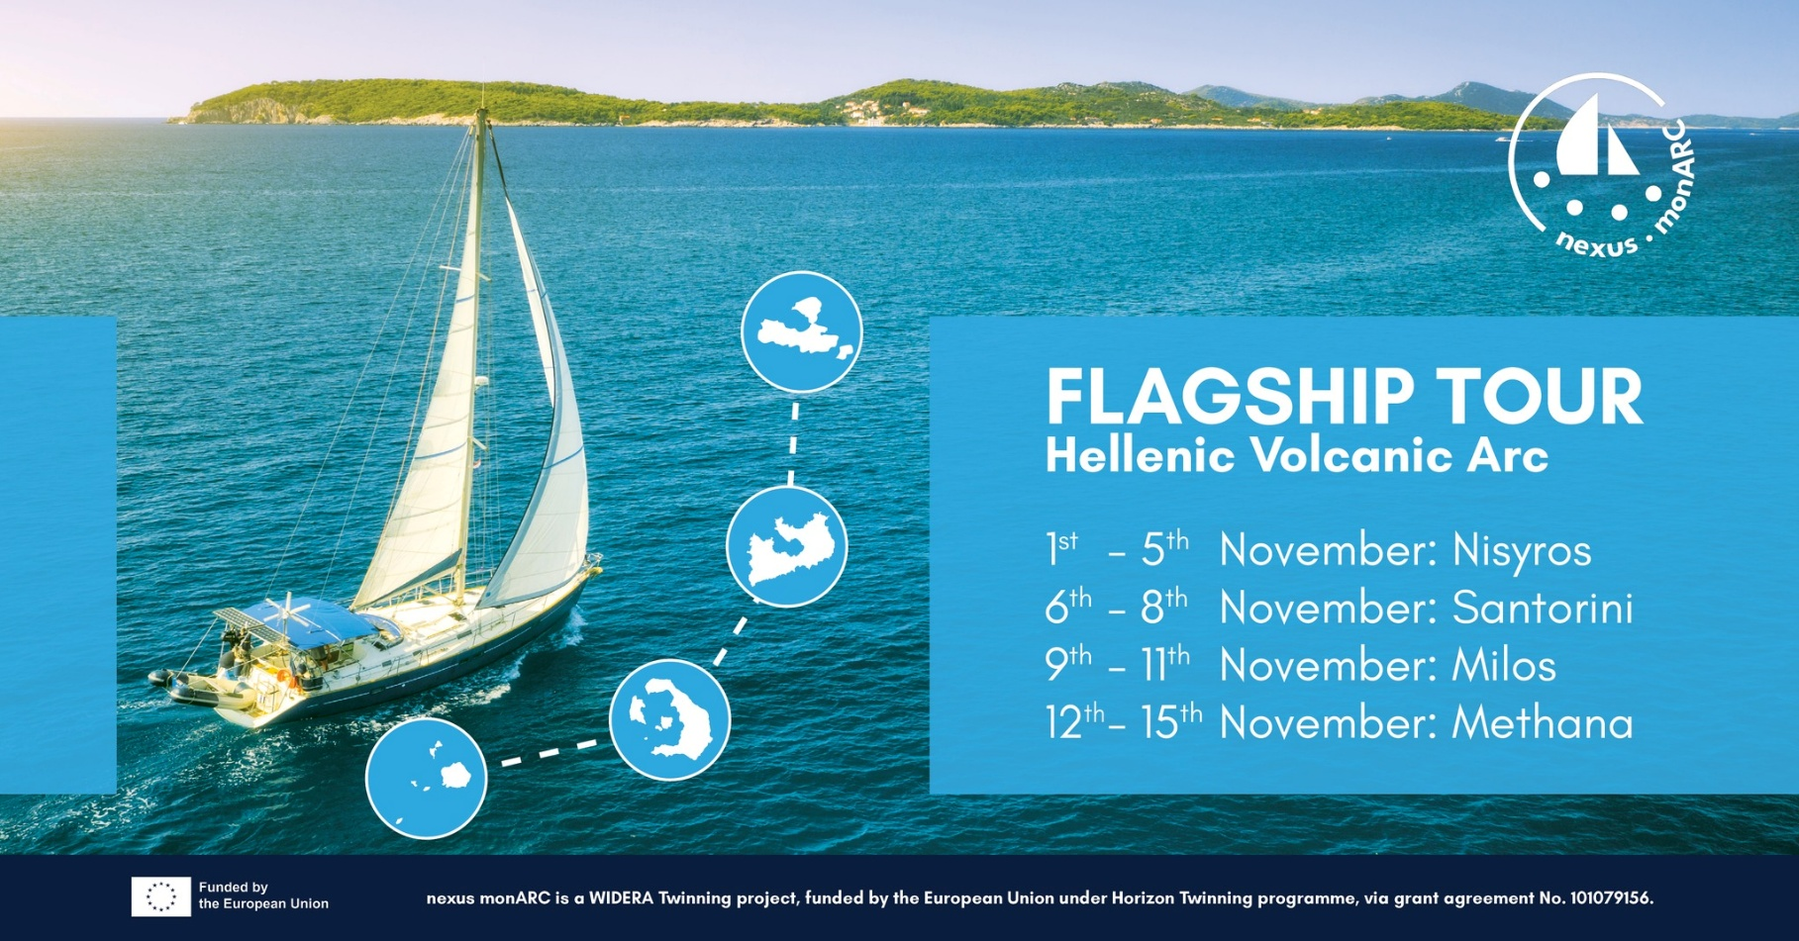
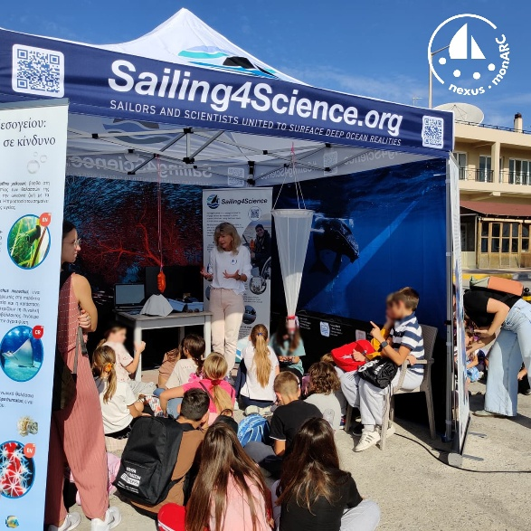
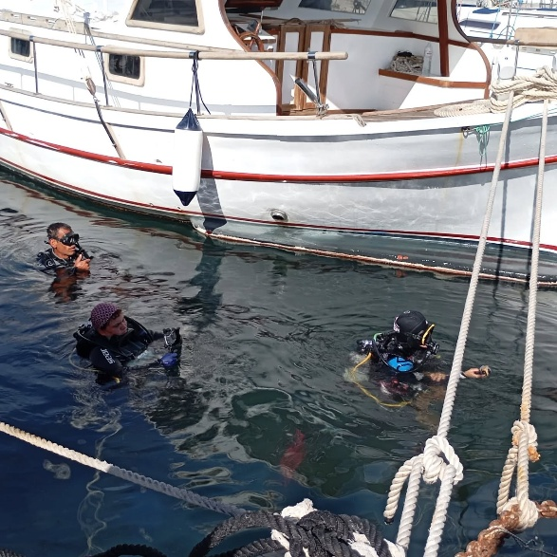
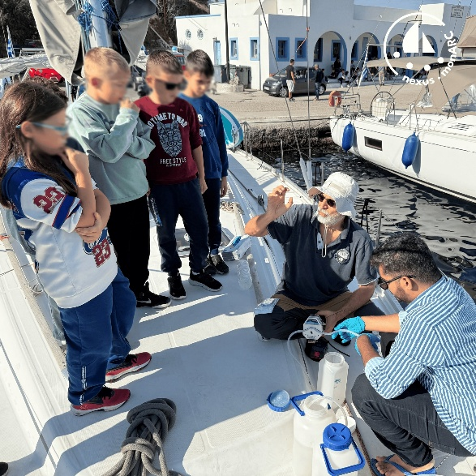
nexus monARC Newsletter
VOL. 4
Setting sail on the Hellenic Volcanic Arc!
From 1st to 15th of November 2025, the crew of nexus monARC scientists navigated across the Hellenic Volcanic Arc, visiting key volcanic islands to conduct monitoring activities, engage with local communities, and share the project’s mission of advancing marine research!
Visit our website at nexusmonarc.eu

Slide 3

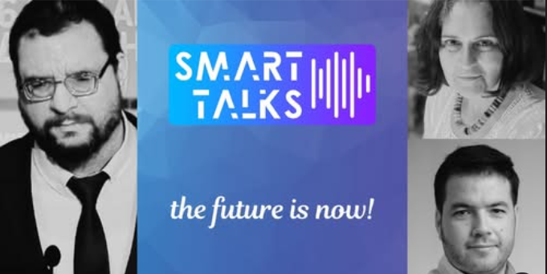
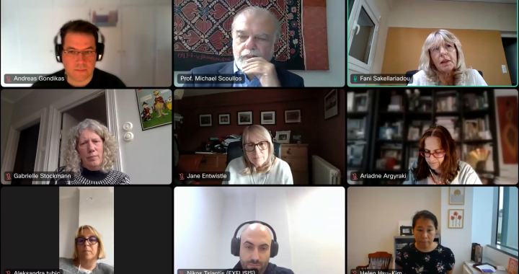

nexus monARC Newsletter
VOL. 4
Highlights
In our latest webinar, Dr. Nadine Meyer from Fresenius University of Applied Sciences, delved into the DPSIR framework by showcasing practical examples, benefits, limitations, and recent modifications.
A must-watch for researchers and practitioners interested in environmental monitoring.
Watch Here: YouTube
Prof. Ariadne Argyraki and researcher Andreas Gondikas discussed nexus monARC and citizen science on the podcast SMART TALKS.
Listen here: YouTube Podcast
On 8 October 2025, we held the Advisory Board Meeting of the nexus monARC project, a highly constructive and inspiring discussion with our advisors and research team. We reflected on the project’s progress, achievements so far, and upcoming steps to further strengthen the link between science, innovation, and societal impact.

Slide 4
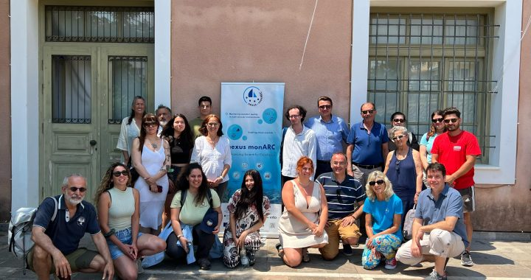
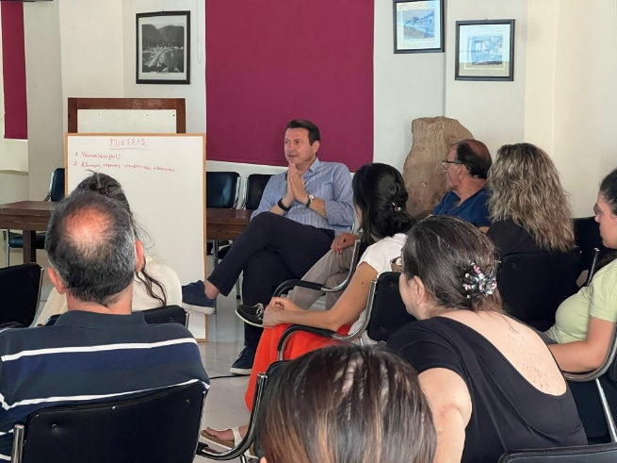
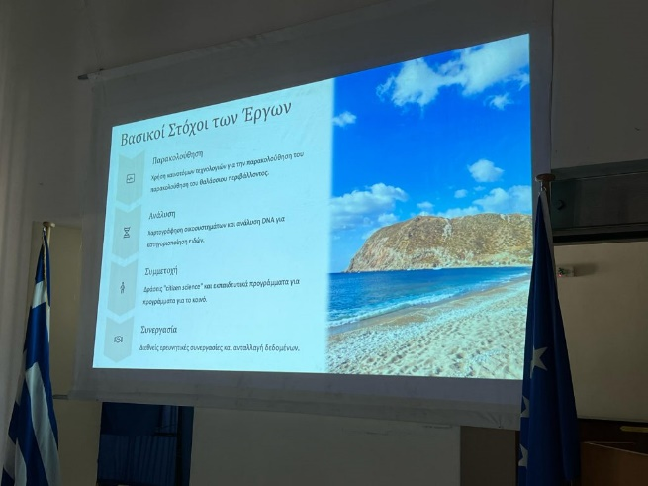
nexus monARC Newsletter
VOL. 4
Summer School in Methana – A Success Story
The nexus-monARC project proudly announces the successful completion of its 2nd Summer School on holistic monitoring of multi-stressor marine environments, held 23–28 June 2025. The program brought together postgraduate students and early-career researchers from physical sciences and engineering for a week of intensive learning combining online lectures and hands-on field activities.
Participants gained practical experience in: Advanced seawater quality monitoring, citizen-science tools, public engagement, comprehensive data management of climate parameters, plastics, nutrient elements, biodiversity, organic pollutants, and radioactivity The first three days featured interactive virtual lectures, followed by three days in Methana, Greece, where participants applied their skills in the field.

Slide 5
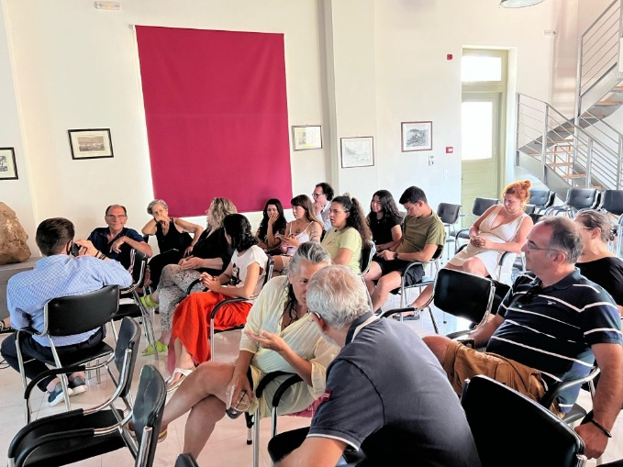
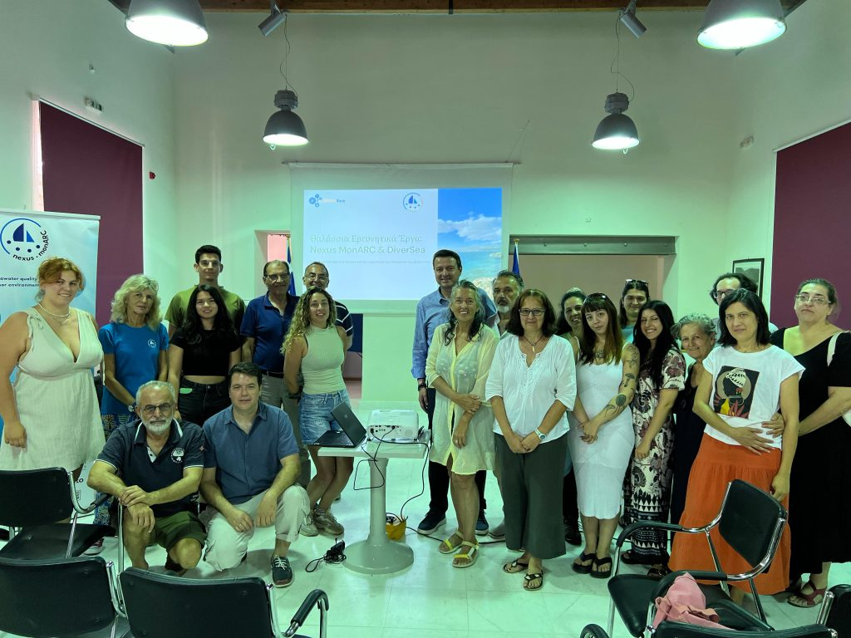
nexus monARC Newsletter
VOL. 4
Techniques included affordable seawater monitoring tools and strategies for community engagement.
A major highlight was the stakeholder meeting held jointly with the DiverSea project at the Cultural Center of Methana. Attendees included: Mayor Anastasios Mougios, Vice-Mayor Vasilios Pantelis, President of the City Council Andreas Tzinieris, President of Methana Loutropolis Community Dimitrios Lamprou, Municipal council members, local residents, and business owners.
The discussion focused on prioritizing environmental pressures, identifying affected sectors, and proposing solutions. Local representatives emphasized opposition to fish farms in the area, citing impacts on tourism. The nexus monARC team extends heartfelt thanks to all instructors, partners, stakeholders, and participants whose enthusiasm made the Summer School a resounding success. By empowering the next generation of scientists and engaging communities, the program strengthens evidence-based management of marine environments across the Hellenic Volcanic Arc.

Slide 6
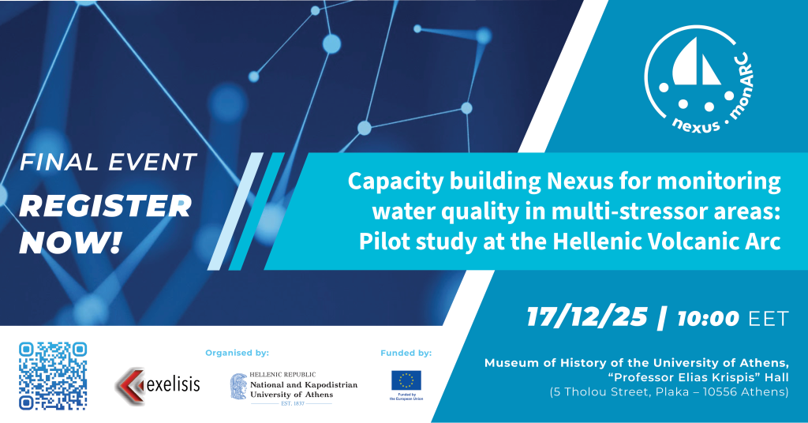
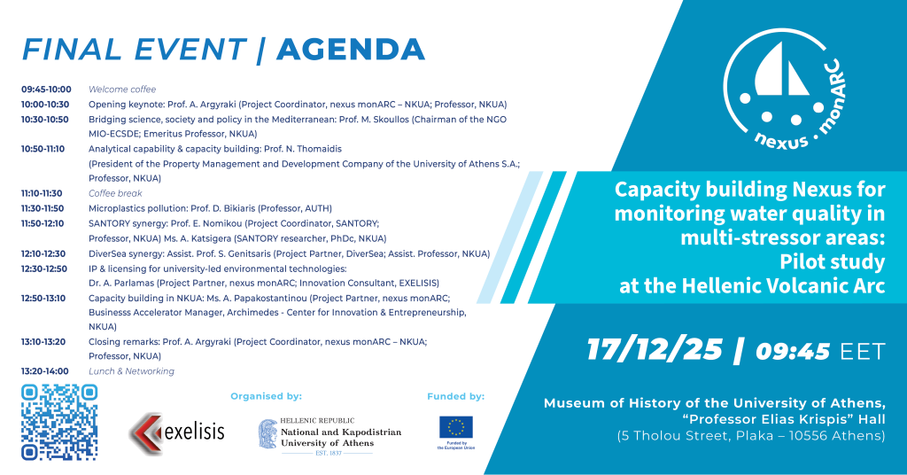
nexus monARC Newsletter
VOL. 4
The Final Event of the Horizon Europe project nexus monARC highlights three years of achievements in advancing scientific excellence, analytical capacity, and collaborative research for marine environmental monitoring in the Hellenic Volcanic Arc.
This event, which is organised by the Department of Geology and Geoenvironment at the National and Kapodistrian University of Athens (NKUA) in partnership with EXELISIS IKE, will be hybrid and will bring together scientists, policymakers, and stakeholders to highlight accomplishments, exchange ideas, and talk about the future of citizen-science based water monitoring throughout the Mediterranean Sea.

